Slide 1




Adobe Analytics
||
||
Collect, Clean, Manipulate, Analyse, Visualise
Challenge
DATA JOURNEY THROUGH DISNEY

Slide 2


DATA ANALYSIS THROUGH DISNEY
Content:
Part 1: Purchasers Behavior
Part 2: Order Value
Indication of first purchases
Features of purchases
How to Encourage it?
Effects of non- purchasers.
How to increase avg. order value up?
Is it depends on Mobile and Desktop?
Lacking Points
What steps should be taken?
Part 3: Mobile vs. Desktop
Part 4: Abandoned carts
Key Differences between purchase flow
How should we treat?
Why this Happens?
Purchasing from there
How often people come there?
Where we are lacking?
Steps should we taken

Slide 3

TEAM INTRODUCTION
TEAM NAME- DATAS
I am Poorvika Gupta. I am working as a team of one. I would like to thank Adobe and Disney both to give us such a nice experience. I also like to thank my faculty, Mr. Ankit Sherawat, to encourage me to take part in this challenge. I really enjoyed this challenge and learned a lot from it.

Slide 4

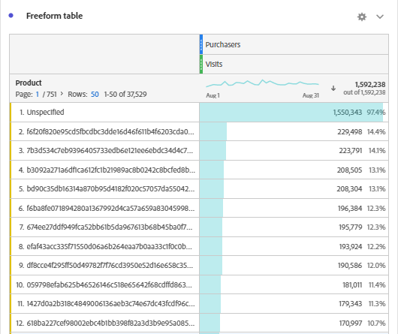
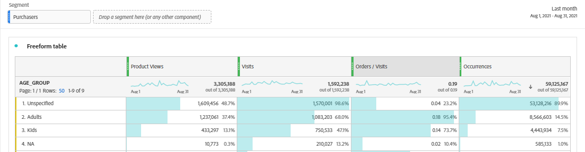
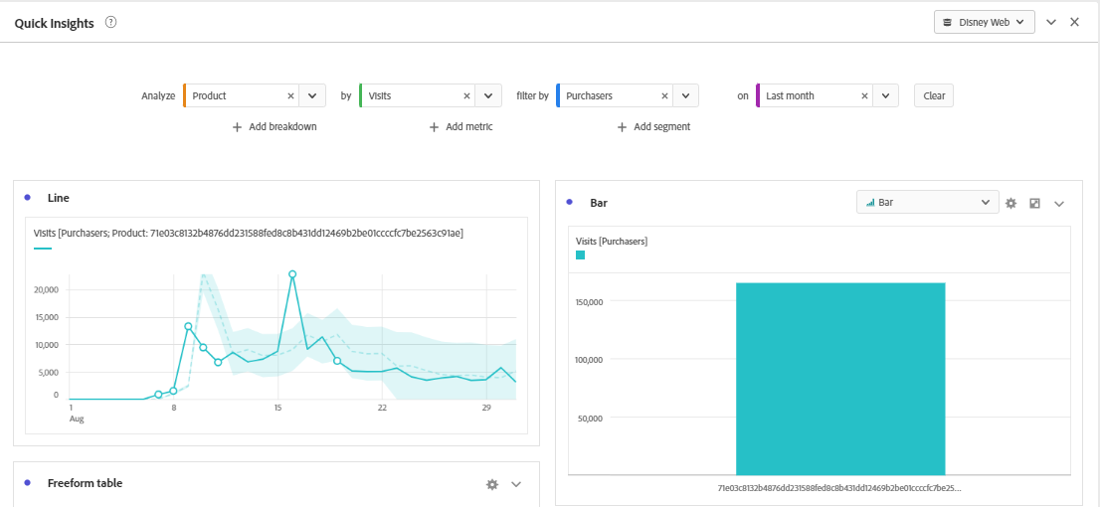
Purchasers Analysis
Part 1: Purchasers behavior
Analysis
Product purchasers by AGE GROUP.
Visits on Products vs. purchases
Visits should be increased for other products
Hike in the middle of the month
In the middle of the month , provide attraction to visit again.

Slide 5
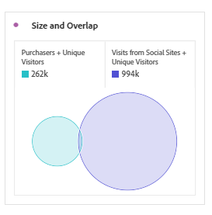
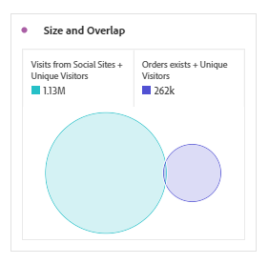
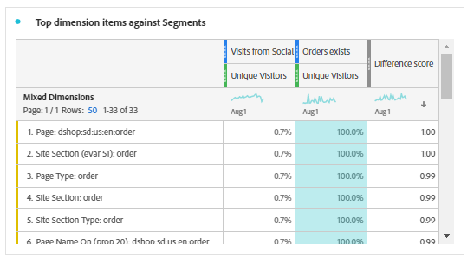
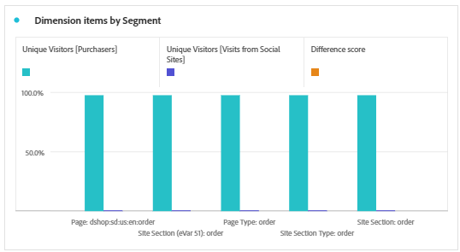
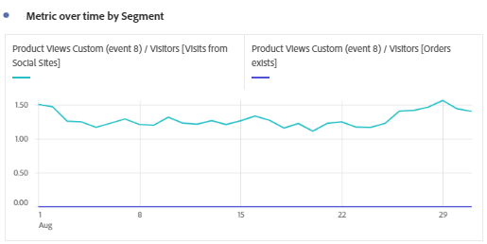
Purchasers’ Visits from Social Sites
Visit/Unique visitors from Social Sites
Order through Social Sites
Only page reviews, no orders exist.
High product views but not the orders.
How to encourage orders?
Should Advertise on different platforms
Front look should influenced people
Sale on different products
Increase marketing channels.
Products should be made attractive with great deals to attract them
Bring more Sponsors.

Slide 6
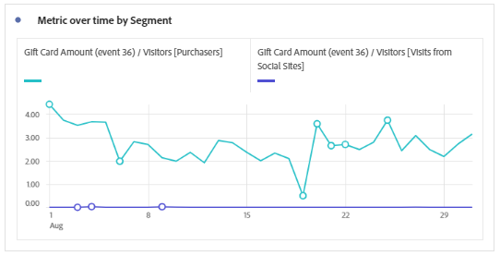
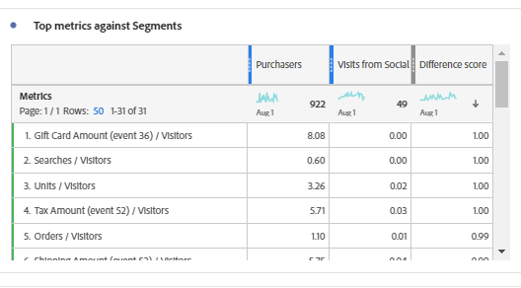
In the middle of the months, give them one cash backs or something.
Different deals on payment method
Provide extra off on visit from social sites
Provide some discount, offers, vouchers and much more
This will force them to visit and purchase again and again

Slide 7
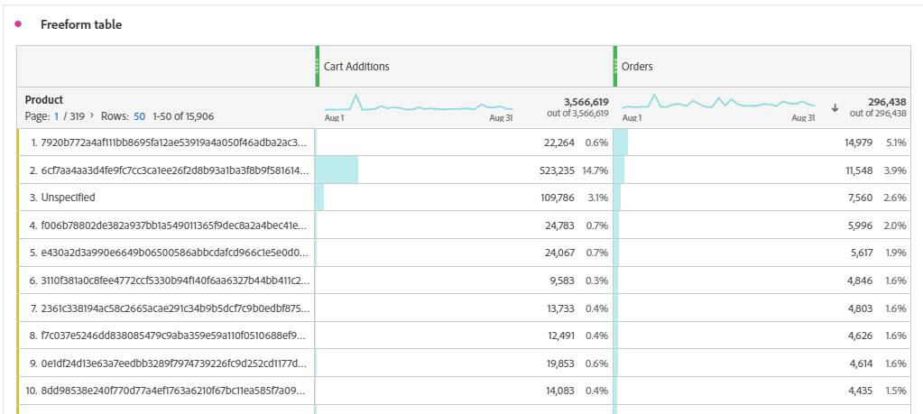
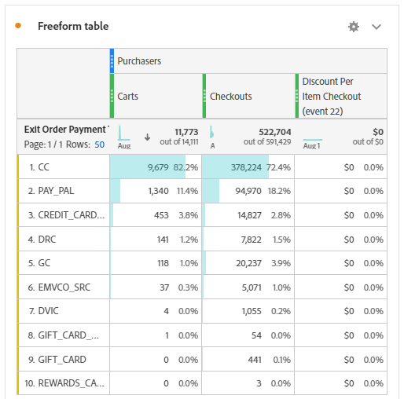
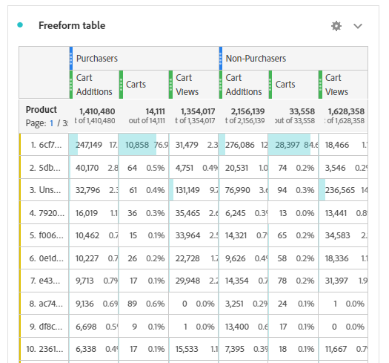
Part 2 : Order Value
Cart addition is more but orders are very less.
To increase order value:
Increase the discounts.
Cart history preference
Checkouts offers
Reviews, quality , delivery date
Cost factor

Slide 8
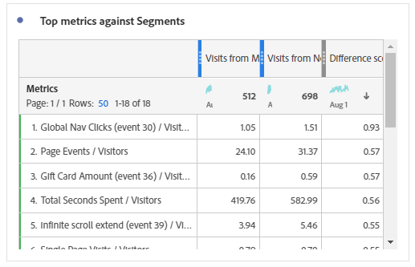
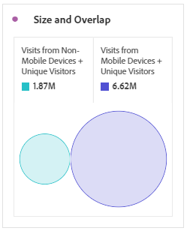
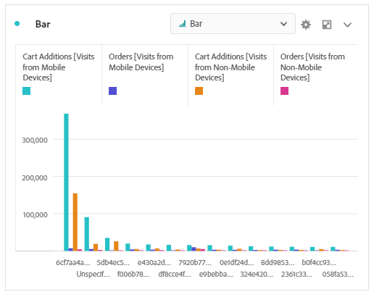
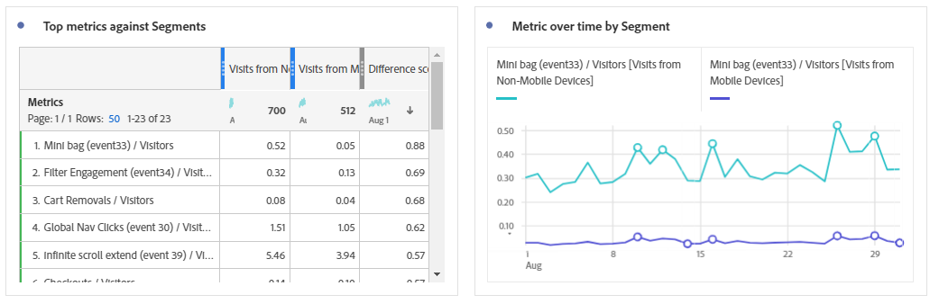
Mobile / Desktop both have different keys of order value.
More people through mobile
Desktop are used by less people.
How users purchase from different devices
Cart addition through mobile and desktop
Gift cards, coupons and offers should be there.
Mini bag should be in the eyes to increase order value.

Slide 9
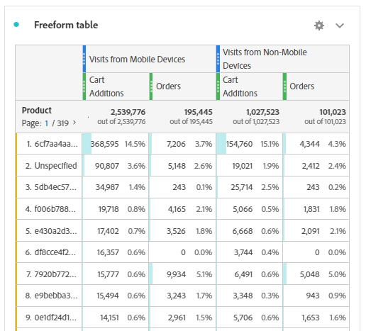
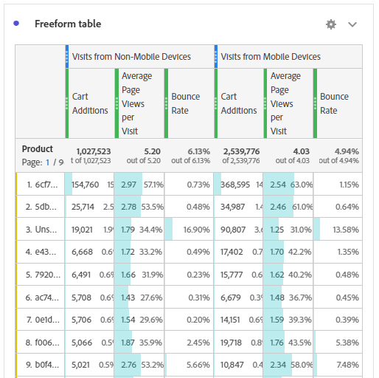
Part 3 : Mobile v/s Desktop
Differently handle
To increase order we should keep the history of carts.
Products should have proper description
Product should have past reviews.
For, non – mobile users , there should be a different panel to search.
Bounce rate in mobile is high than in non- mobile users.

Slide 10
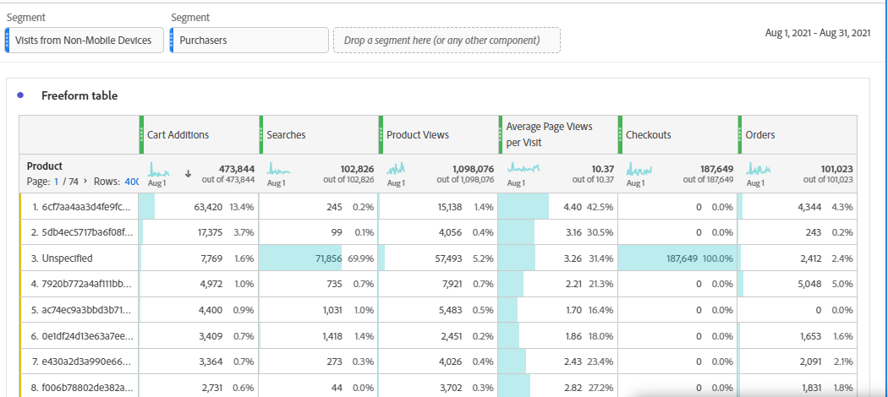
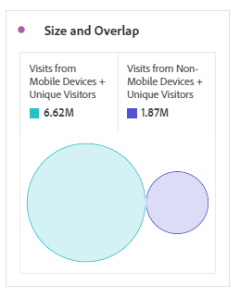
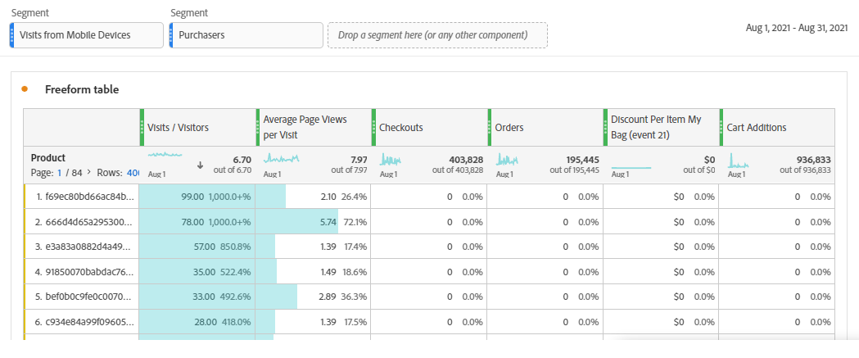
Purchasers’ behavior from Mobile and Non-Mobile
Difference between users through mobile and non- mobile
Non- mobile has still some orders.
To maintain it, we can launch some products having large value.
No orders through mobile
Should increase our marketing through small sites to get orders through mobile.
Should give some discounts on purchasing from cart.

Slide 11
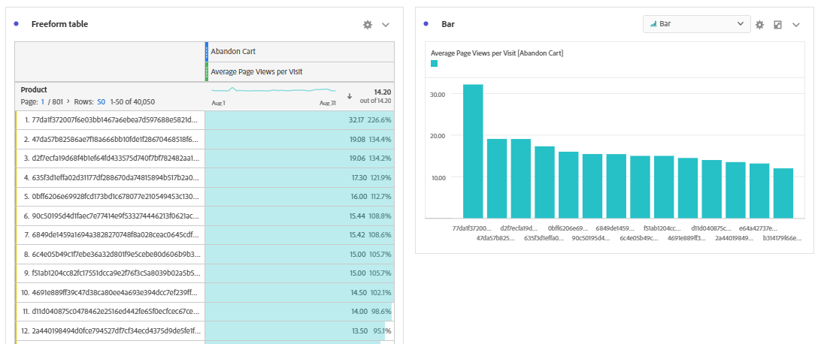
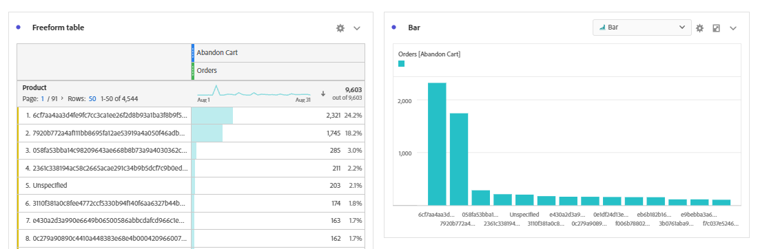
Part 4 : Abandoned Cart
Visits are high on abandoned cart
Very less orders though

Slide 12
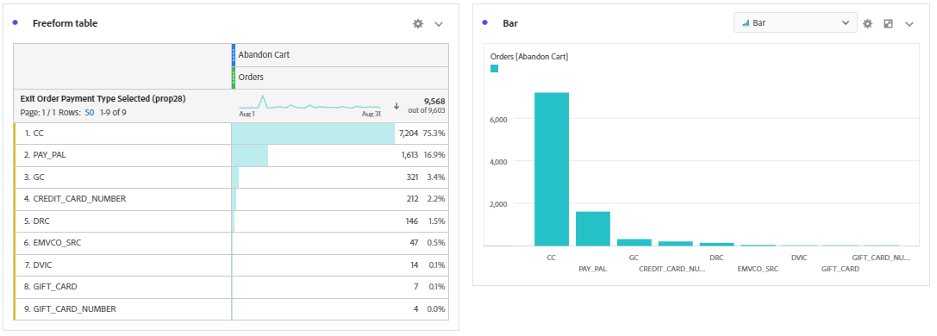
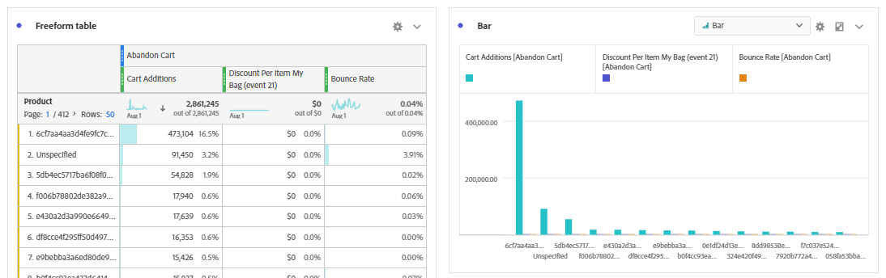
To increase the rate of orders through abandoned cart:
Provide some guarantee of the product
Provide vouchers on different payment methods
Provide discounts.
Include special offers on purchase from abandoned cart
Show them different products on the basis of their cart

Slide 13
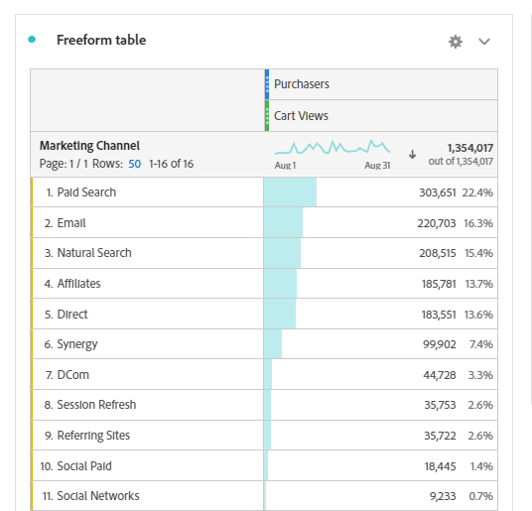
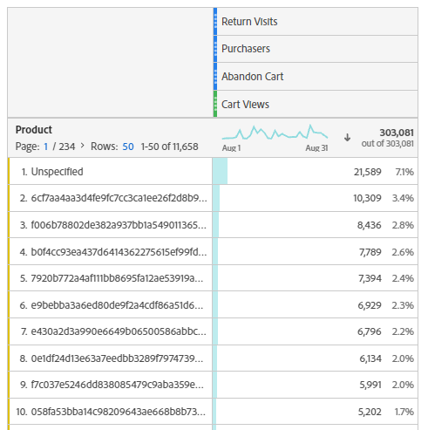
How marketing channel helps to bring purchasers
We should increase this number .
Marketing channels should be increased
This shows how many people return to see their carts
There should be a automatic reminder sent to their mail or mobile .

Slide 14
Thank You
Any Question?
Please Ask!

